Slide 1

Morning Joe: Visualizing Coffee Rust, Production and Futures
Data Visualization | Fall 2017 | Indiana University | Mid-Term Presentation
by Orly Esteban, Laura Kahn and Ravinder Lambadi

Slide 2
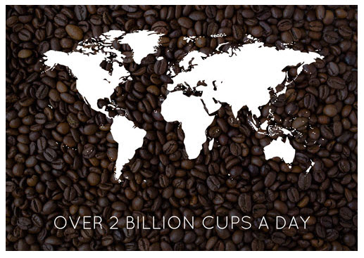
Motivation
More than 2 billion cups of coffee consumed each day.
Livelihood of 120 million people depends on coffee supply chain.
Coffee is the second most popular traded commodity, worth over $100 billion annually.

Slide 3
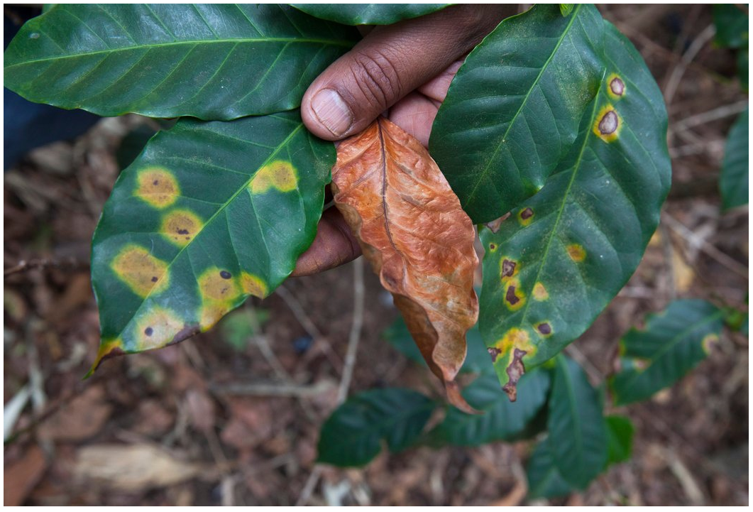
Motivation
Coffee rust, which causes plant leaves to turn yellow, causes more than $500 million in production losses every year.
Data visualization will help understand the relationship between coffee rust, production and futures.

Slide 4
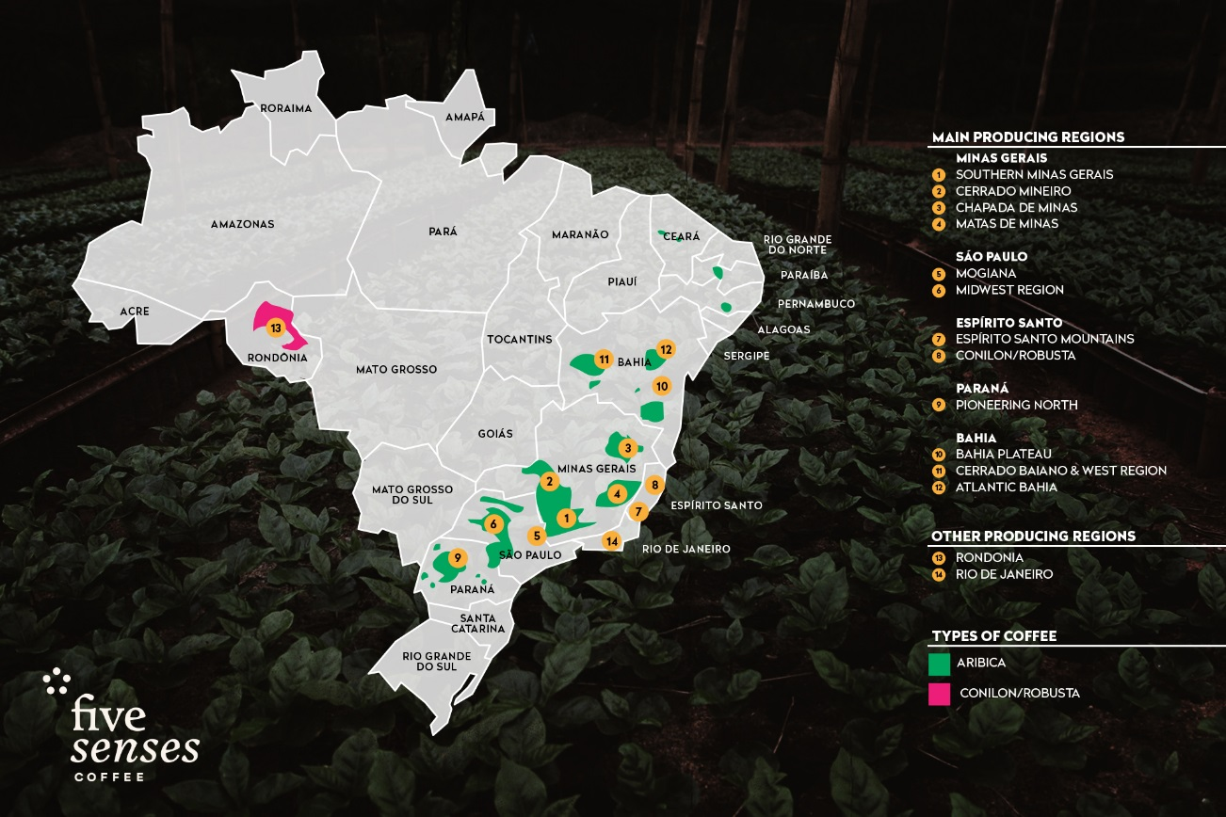
Research Question and Scope
Is there a link between the amount of coffee rust and production and / or futures prices?
Café Arabica data from Brasil (2005-2006 and 2008-2009), Colombia (1995 and 2011-2013) and Papa New Guinea (1989-1991).

Slide 5
Hypotheses
More rain increases coffee rust.
Higher temperatures increases coffee rust.
More coffee rust decreases production.
More coffee production decreases futures.

Slide 6
Existing Research
Magrach describes how temperature and rain affect the amount of coffee rust.
Avelino suggests a qualitative link between coffee rust and prices.
Montage uses machine learning to predict futures prices of commodities.

Slide 7
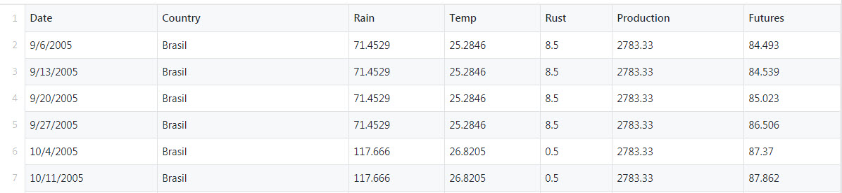
Data Acquisition
Variables :
Monthly rainfall
Monthly temperature
Rust %
Monthly production amount
Weekly futures prices
Final cleaned data in CSV for processing.

Slide 8
Data Acquisition
Challenges:
Learn domain quickly to find relevant data
Translate Portuguese & Spanish documents to get data
Combine data from 10+ sources.

Slide 9
Data Assumptions & Limitations
Since altitudes are similar for Brasil (1010m), Colombia (1310 m) and Papa New Guinea (1410 m), it’s ok to compare rust data from these countries.
Future prices are worldwide and not by country.
Analysis is limited by openly available data accuracy.

Slide 10
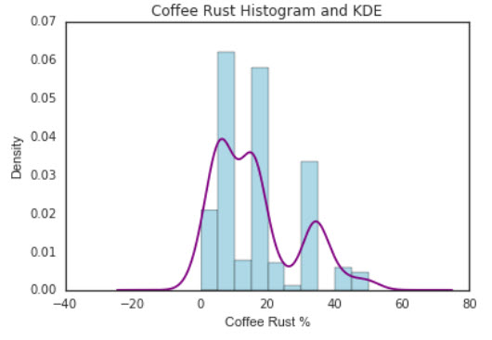
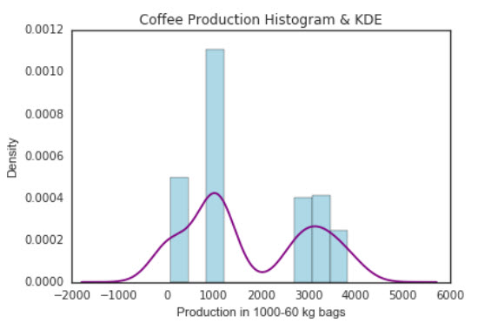
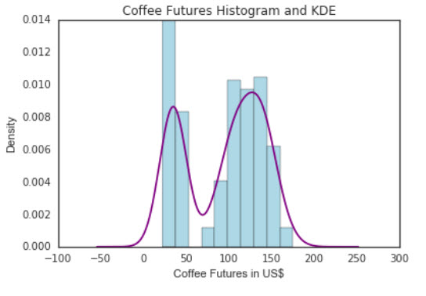
How is the Data Distributed?
The histogram and kernel density estimate (KDE) show the distribution of attributes – Rust, Production and Futures.

Slide 11
How is the Data Distributed?
Coffee Rust peaks between 5-20%.
Coffee Production peaks at 1000 and then 3000-4000 (1000 - 60kg bags).
Coffee Futures histogram peaks around 50 and 125 US$.

Slide 12
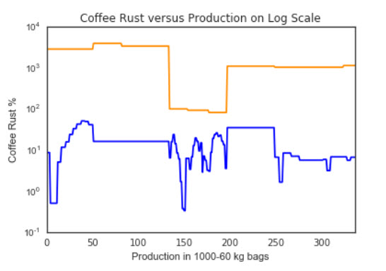
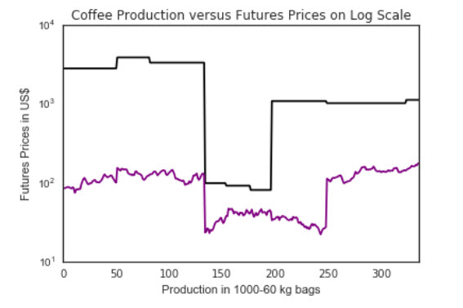
Finding Data Relationships
Use scatter plots to visualize relationship between rust and production and production and futures variables. We don’t plot rain or temperature since they aren’t correlated.
Use log scale for these plots since data ranges have big difference.

Slide 13
Finding Data Relationships
Rust and Production are probably correlated to each other.
Production and futures are probably correlated to each other.

Slide 14
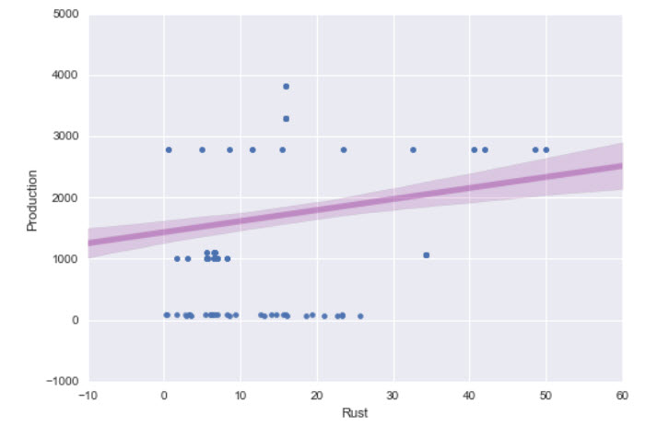
Rust and Production Relationships
Linear regression visualization shows that Rust and Production are linearly correlated to each other.
Increase in rust = increase in production (fail to accept original hypothesis)

Slide 15
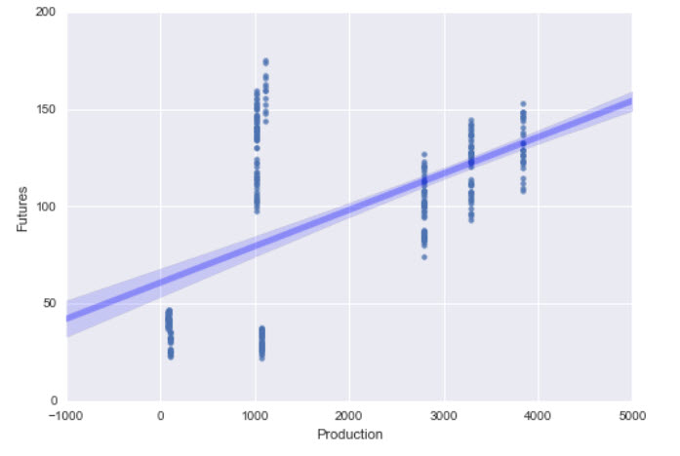
Production and Futures Relationships
Linear regression visualization shows that Production and Futures are linearly correlated to each other.
Increase in production = increase in futures (fail to accept original hypothesis)

Slide 16
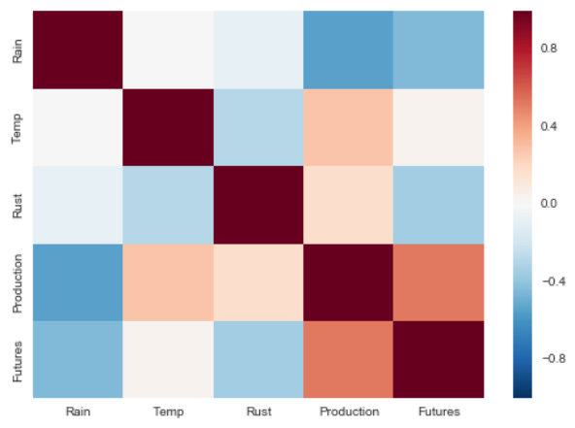
Are the Variables Correlated?
In a correlation matrix, each variable is represented.
Variables that are positively correlated (> 0.1) change in the same direction.
Variables that are negatively correlated (< -0.1) change in the opposite direction.

Slide 17
Are the Variables Correlated?
Increase in rain = less rust
Increase in temperature = less rust
Increase in rust = increase in production
Increase in production = increase in futures
Do not accept any of the original hypotheses!

Slide 18
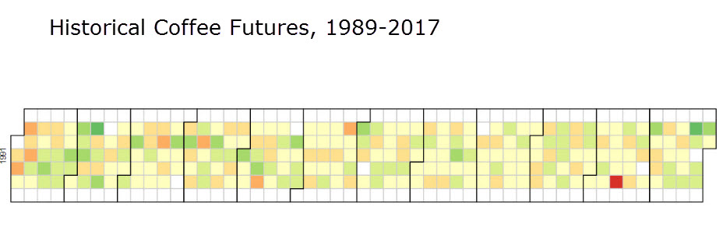
Future Work
Create web page to tell the story of coffee rust, production and futures using D3 and HTML.
Add Calendar view using D3 that shows Historical Coffee Futures by month as you hover over.

Slide 19
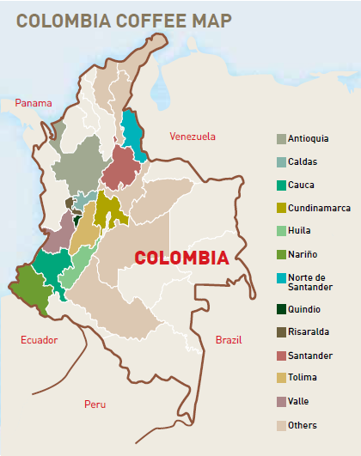
Future Work
The coffee growing map of Colombia will be modified
Replace similar blue and greens with more contrasting colors

Slide 20
References
https://github.com/thedatalass/DataVizMisc/blob/master/YY-MidTerm_references

